Slide 1
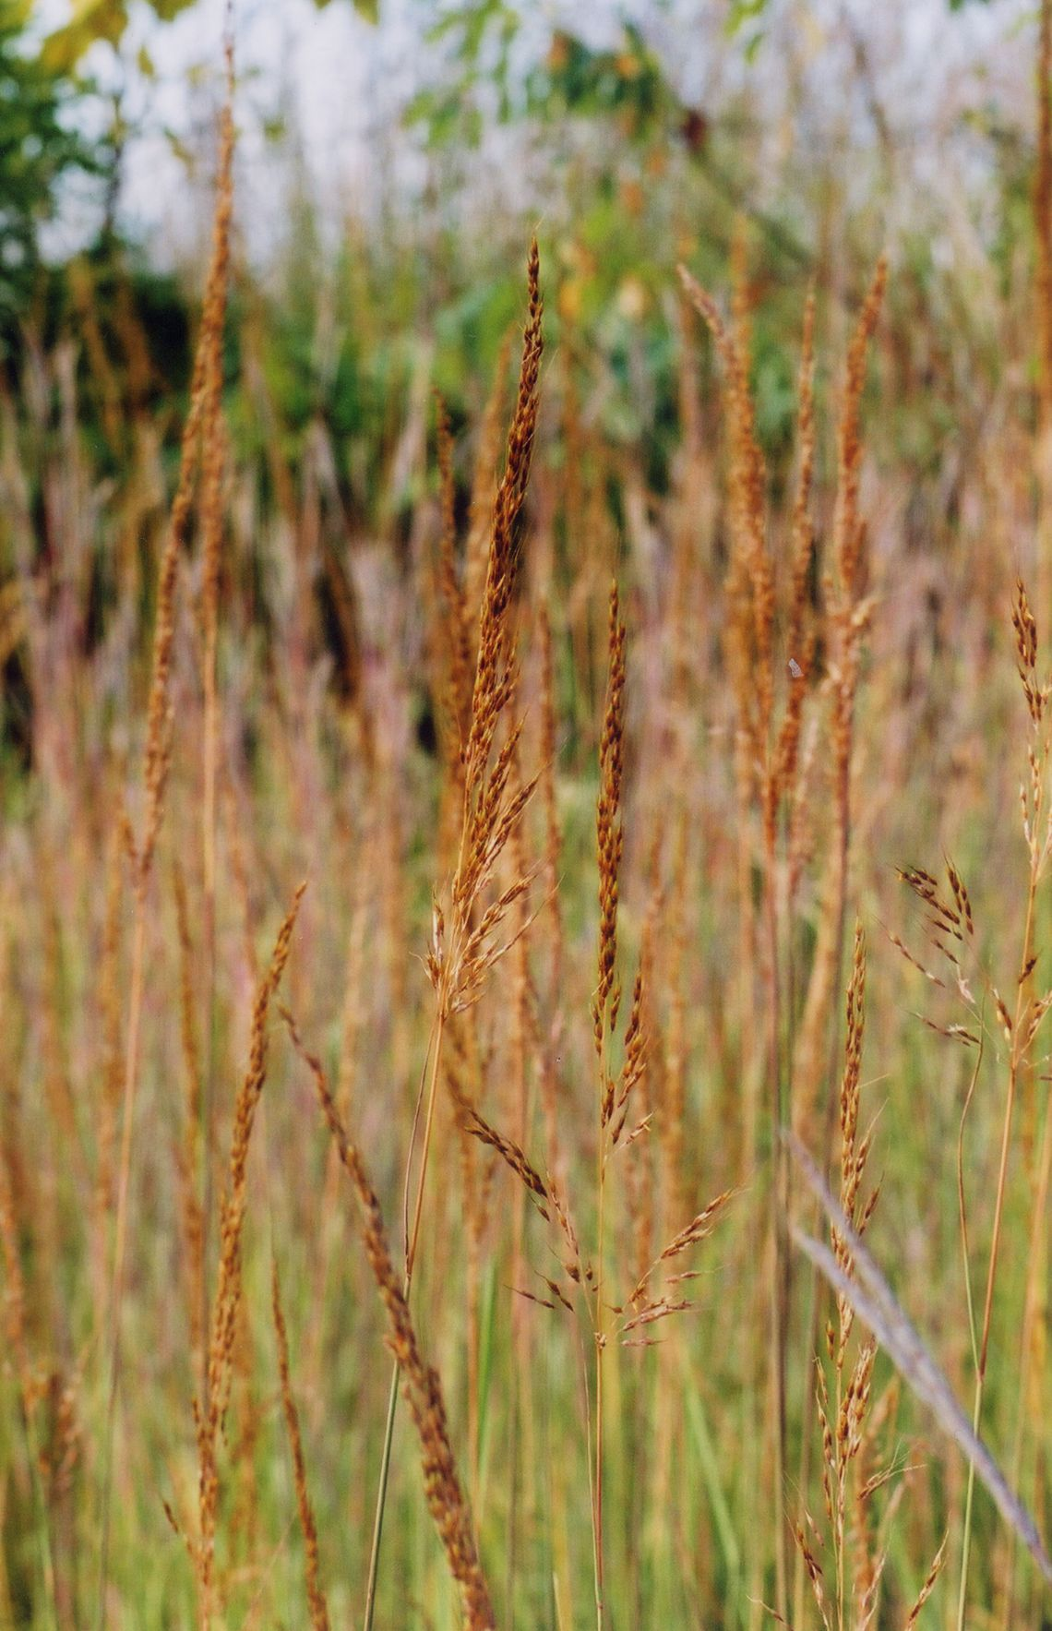
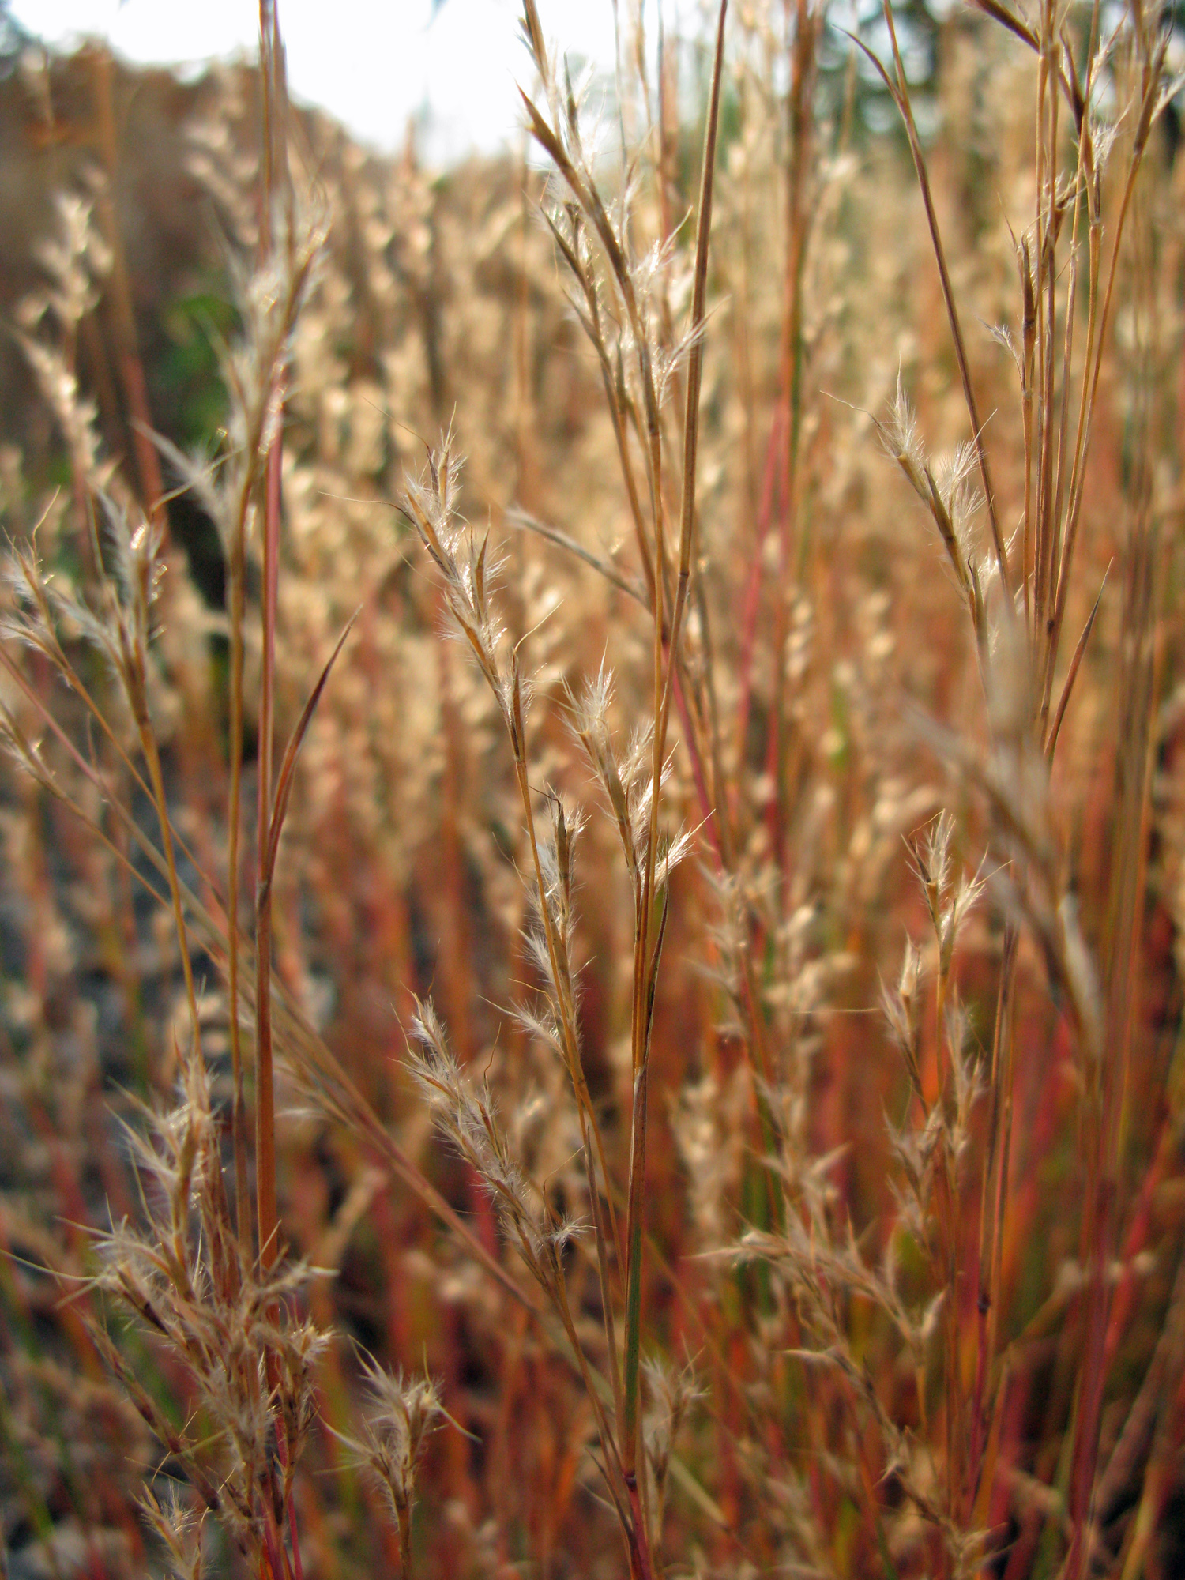
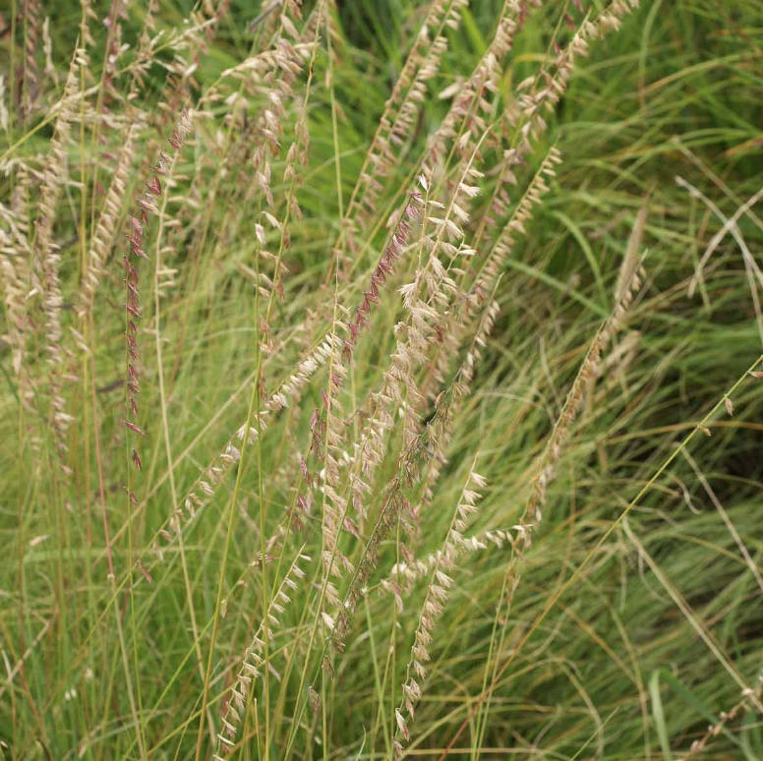
Most abundant grasses
Little bluestem
Schizachyrium scoparium
Indiangrass
Sorghastrum nutans
Sideoats grama
Bouteloua curpentendula
40.92% seed mix
12-50% vegetative cover
1.07% seed mix
2-4% vegetative cover
3.60% seed mix
1-12% vegetative cover
Notes:
https://wrangle.org/ecotype/north-american-tall-grass-prairie

Slide 2
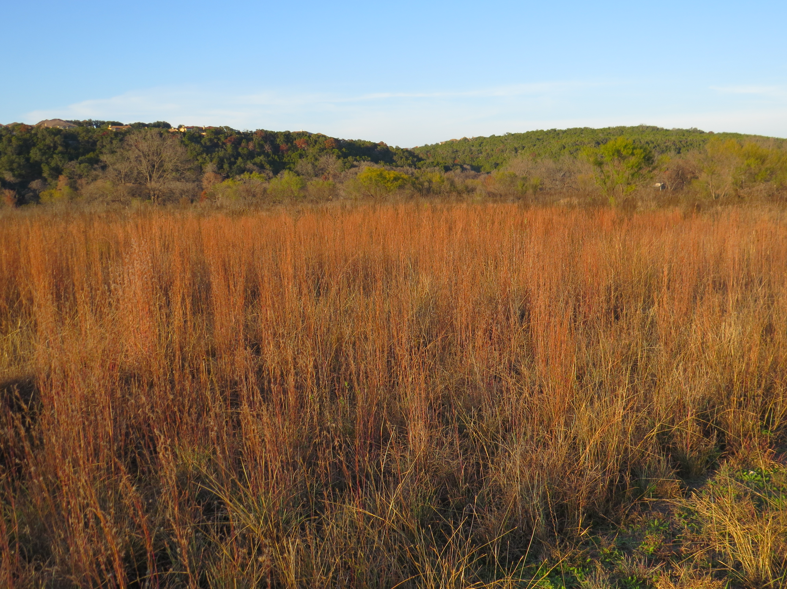
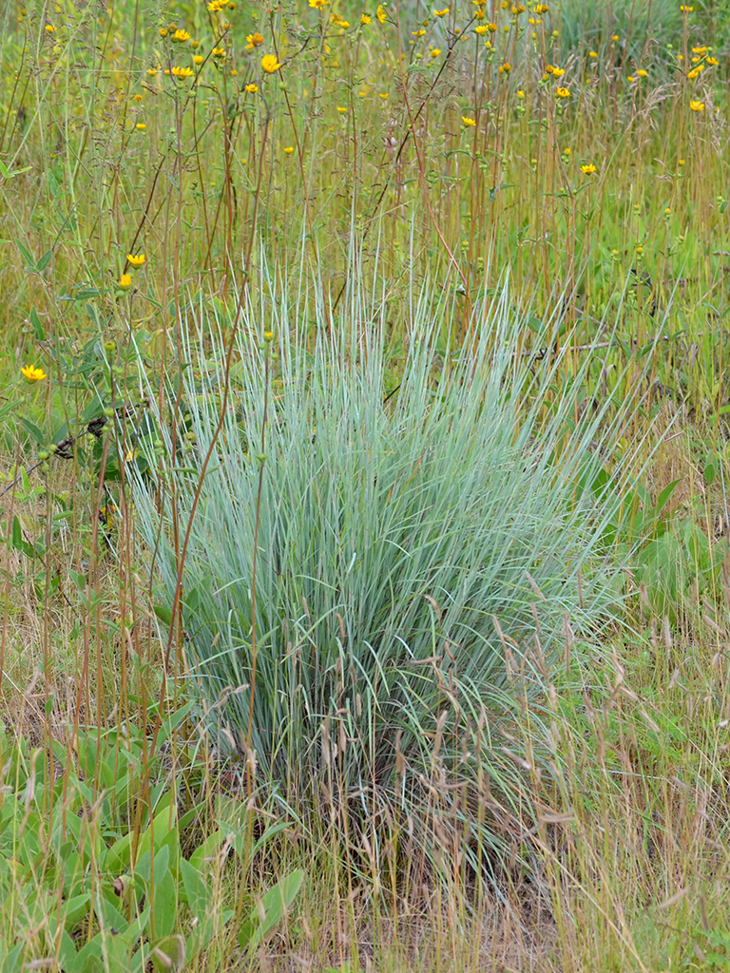
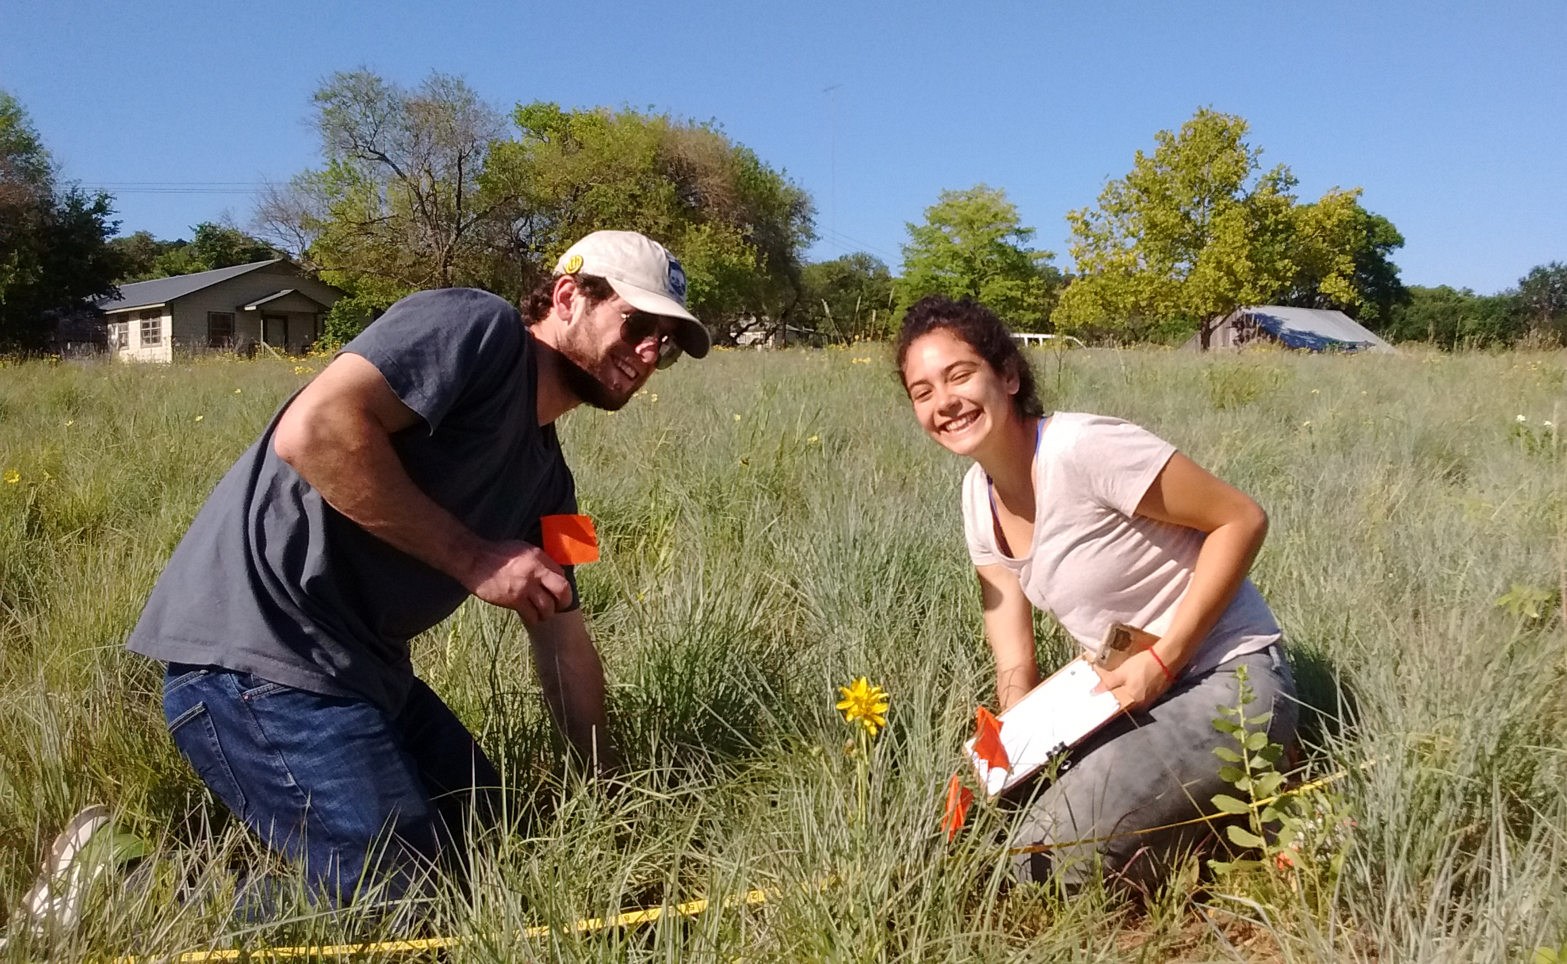
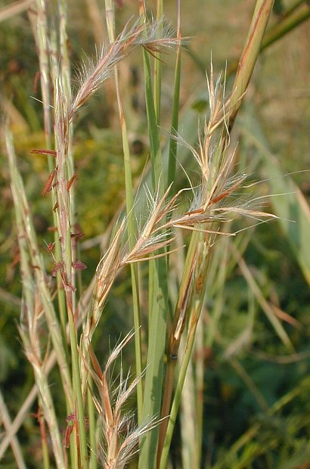
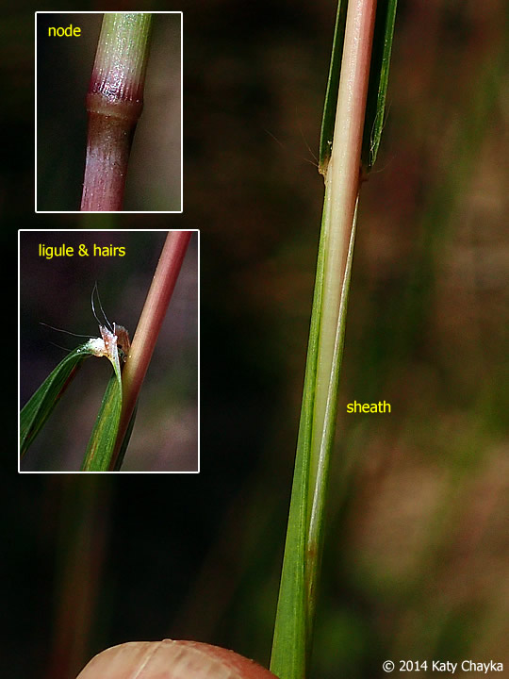
Little Bluestem
Schizachyrium scoparium
Photo credit: https://www.flickr.com/photos/commonsfordpro/
Notes:
https://www.johnson.k-state.edu/docs/crops-livestock/native-grass-seed/Native%20Grass%20ID.pdf

Slide 3
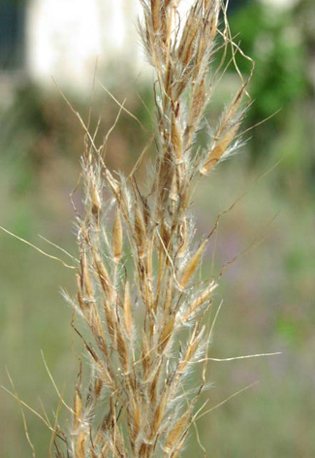
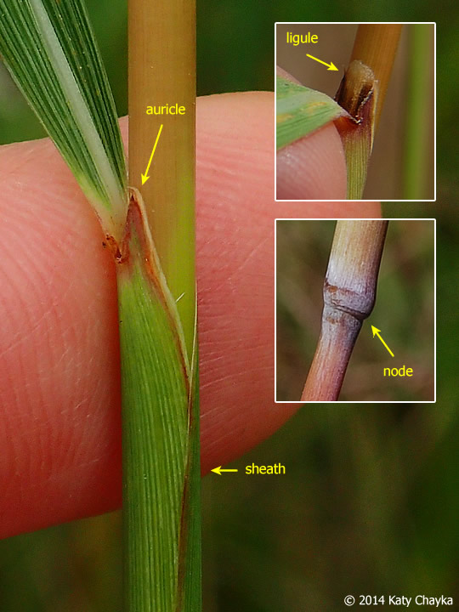
Indiangrass
Sorghastrum nutans

Slide 4
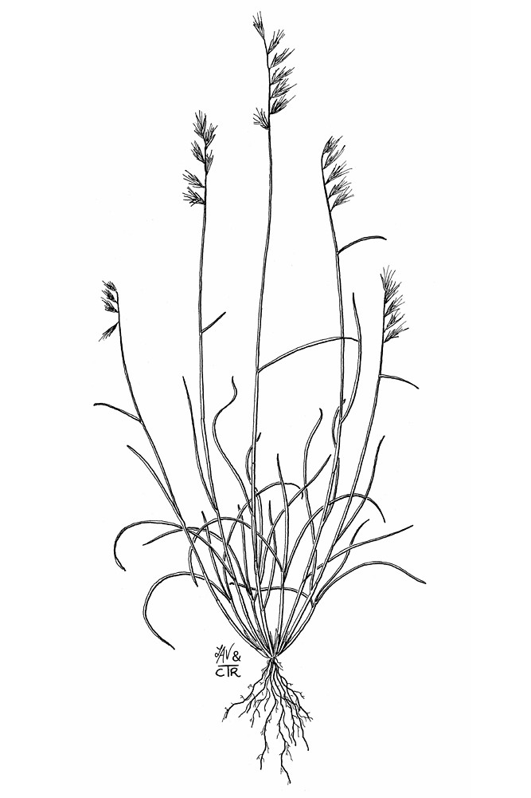
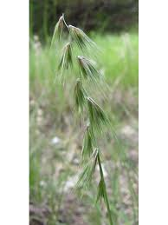
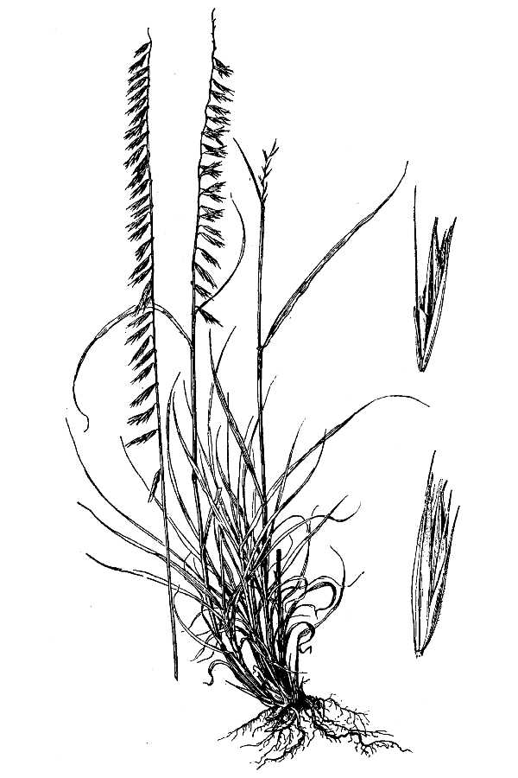
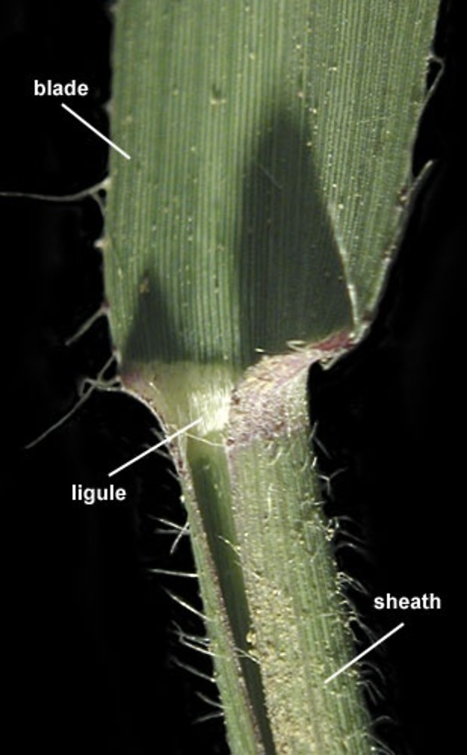
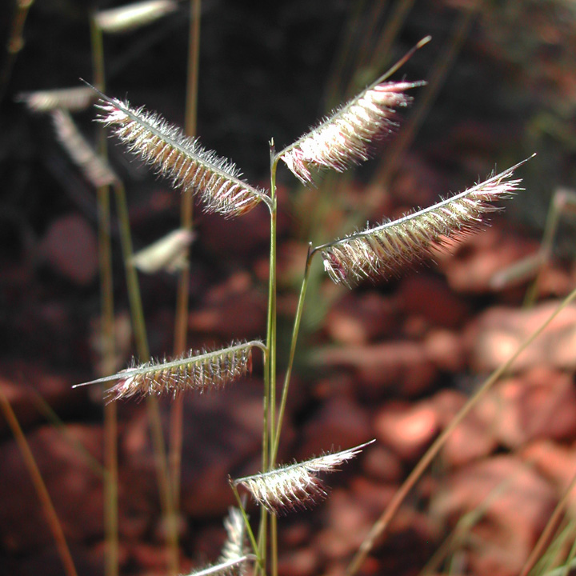
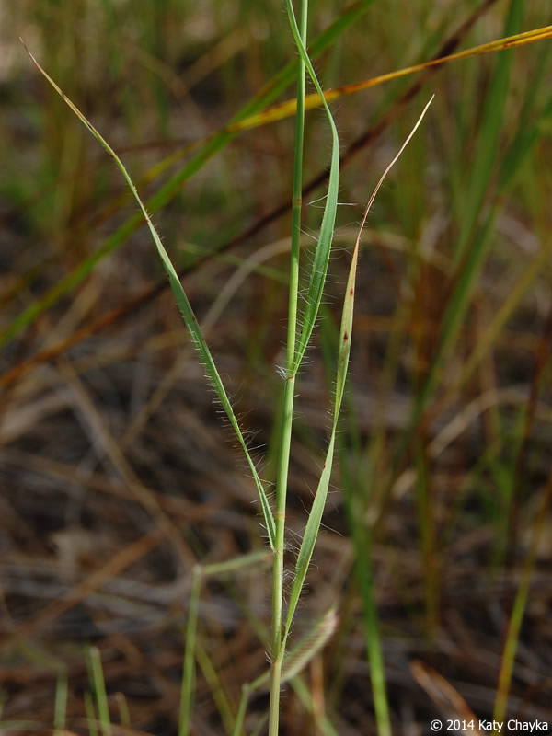
Grama grasses
Texas grama
Bouteloua rigidiseta
Sideoats grama
Bouteloua curpentendula
Hairy grama
Bouteloua hirsuta
Notes:
http://www.soilcropandmore.info/crops/Grasses/Texas_grama/Texas-Grama-Bouteloua-rigidiseta.htm

Slide 5
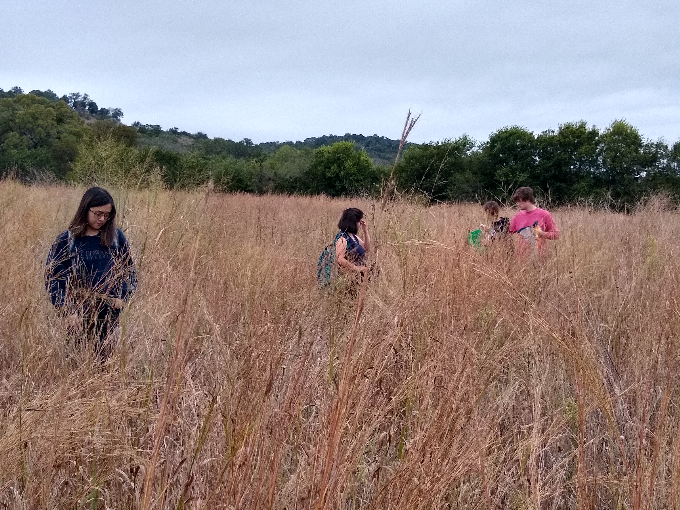
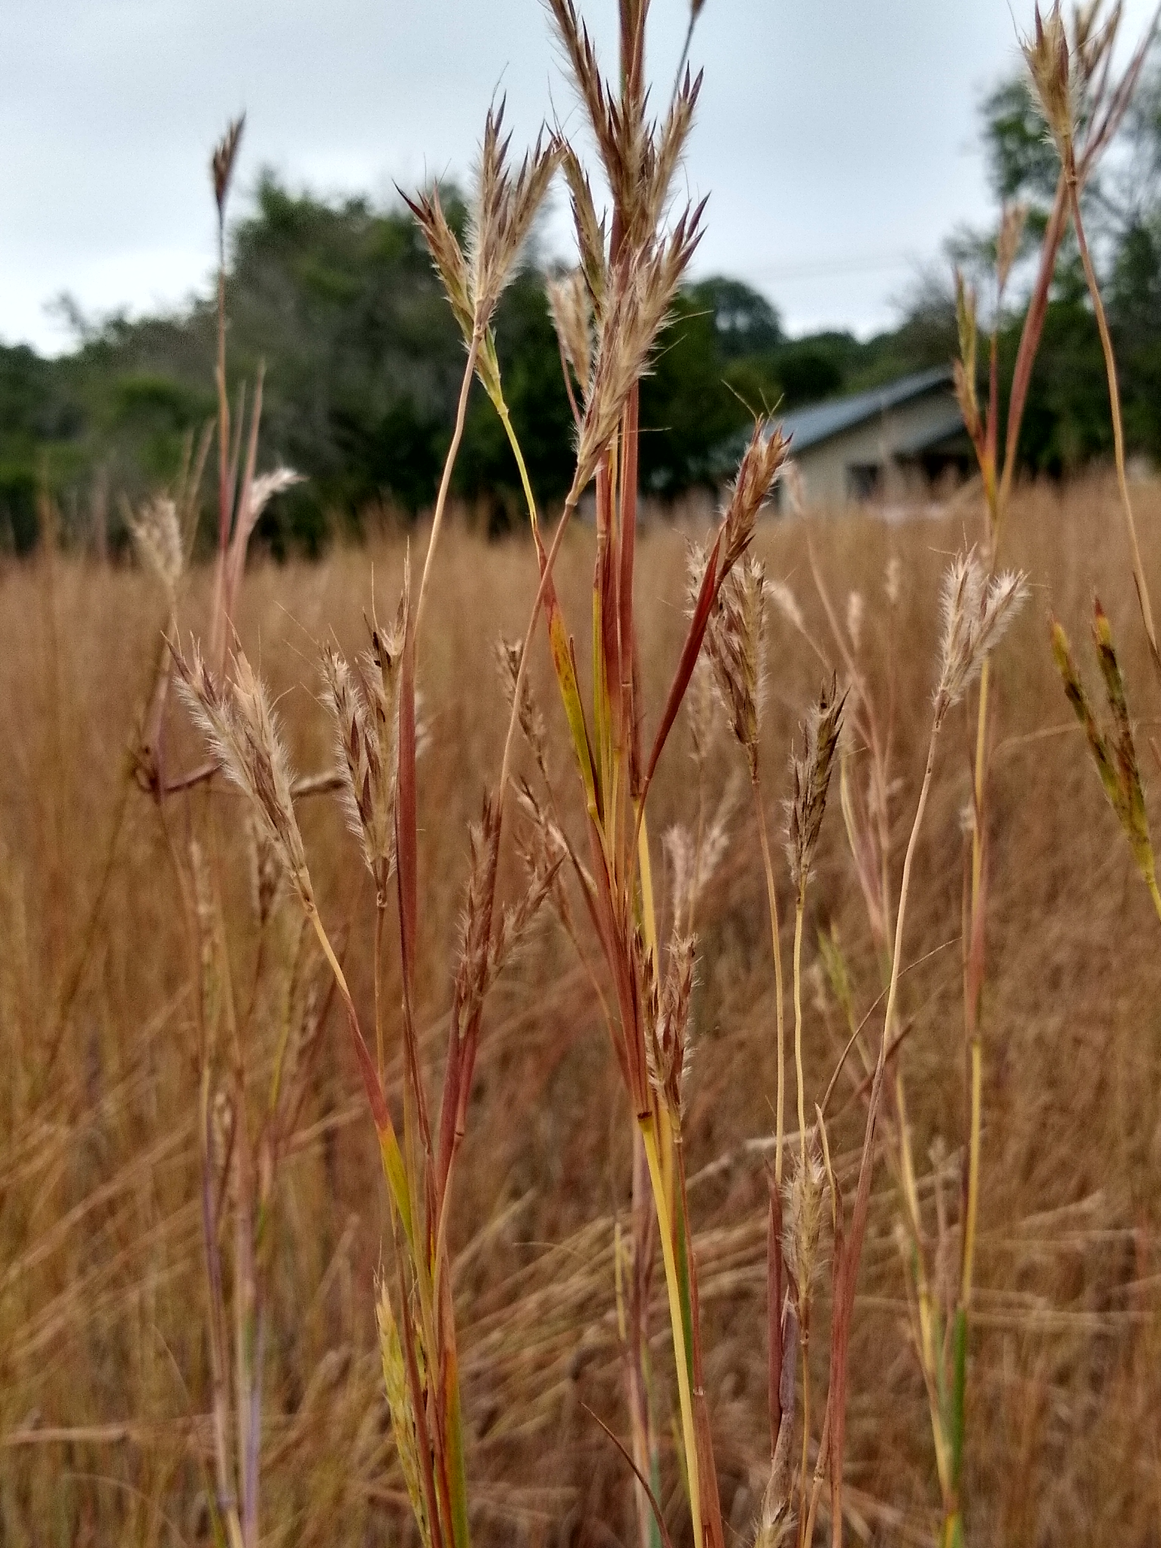
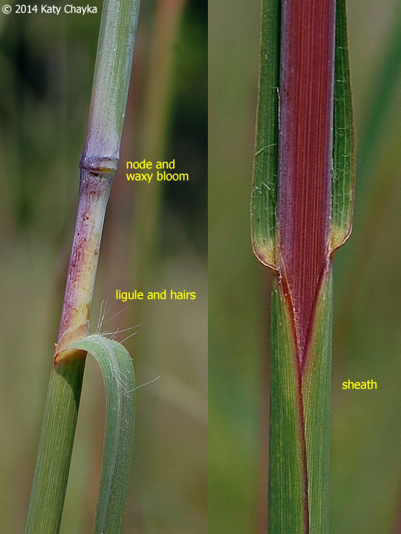
Andropogon gerardi
Big bluestem!
Notes:
https://www.minnesotawildflowers.info/grass-sedge-rush/big-bluestem

Slide 6
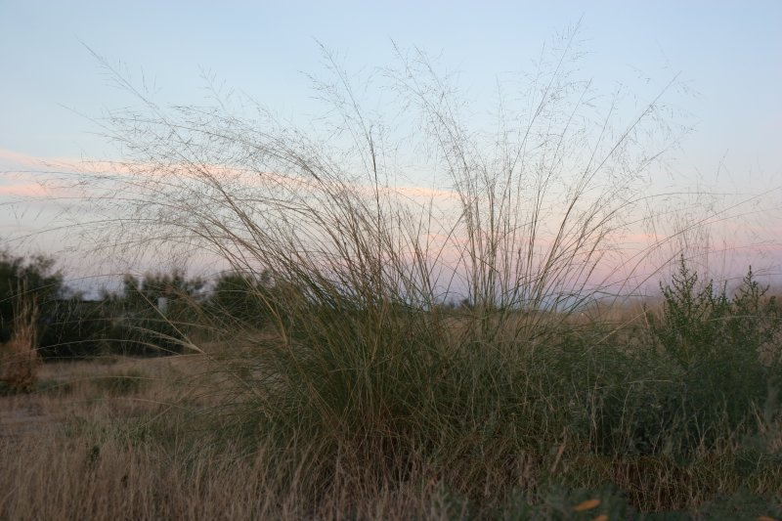
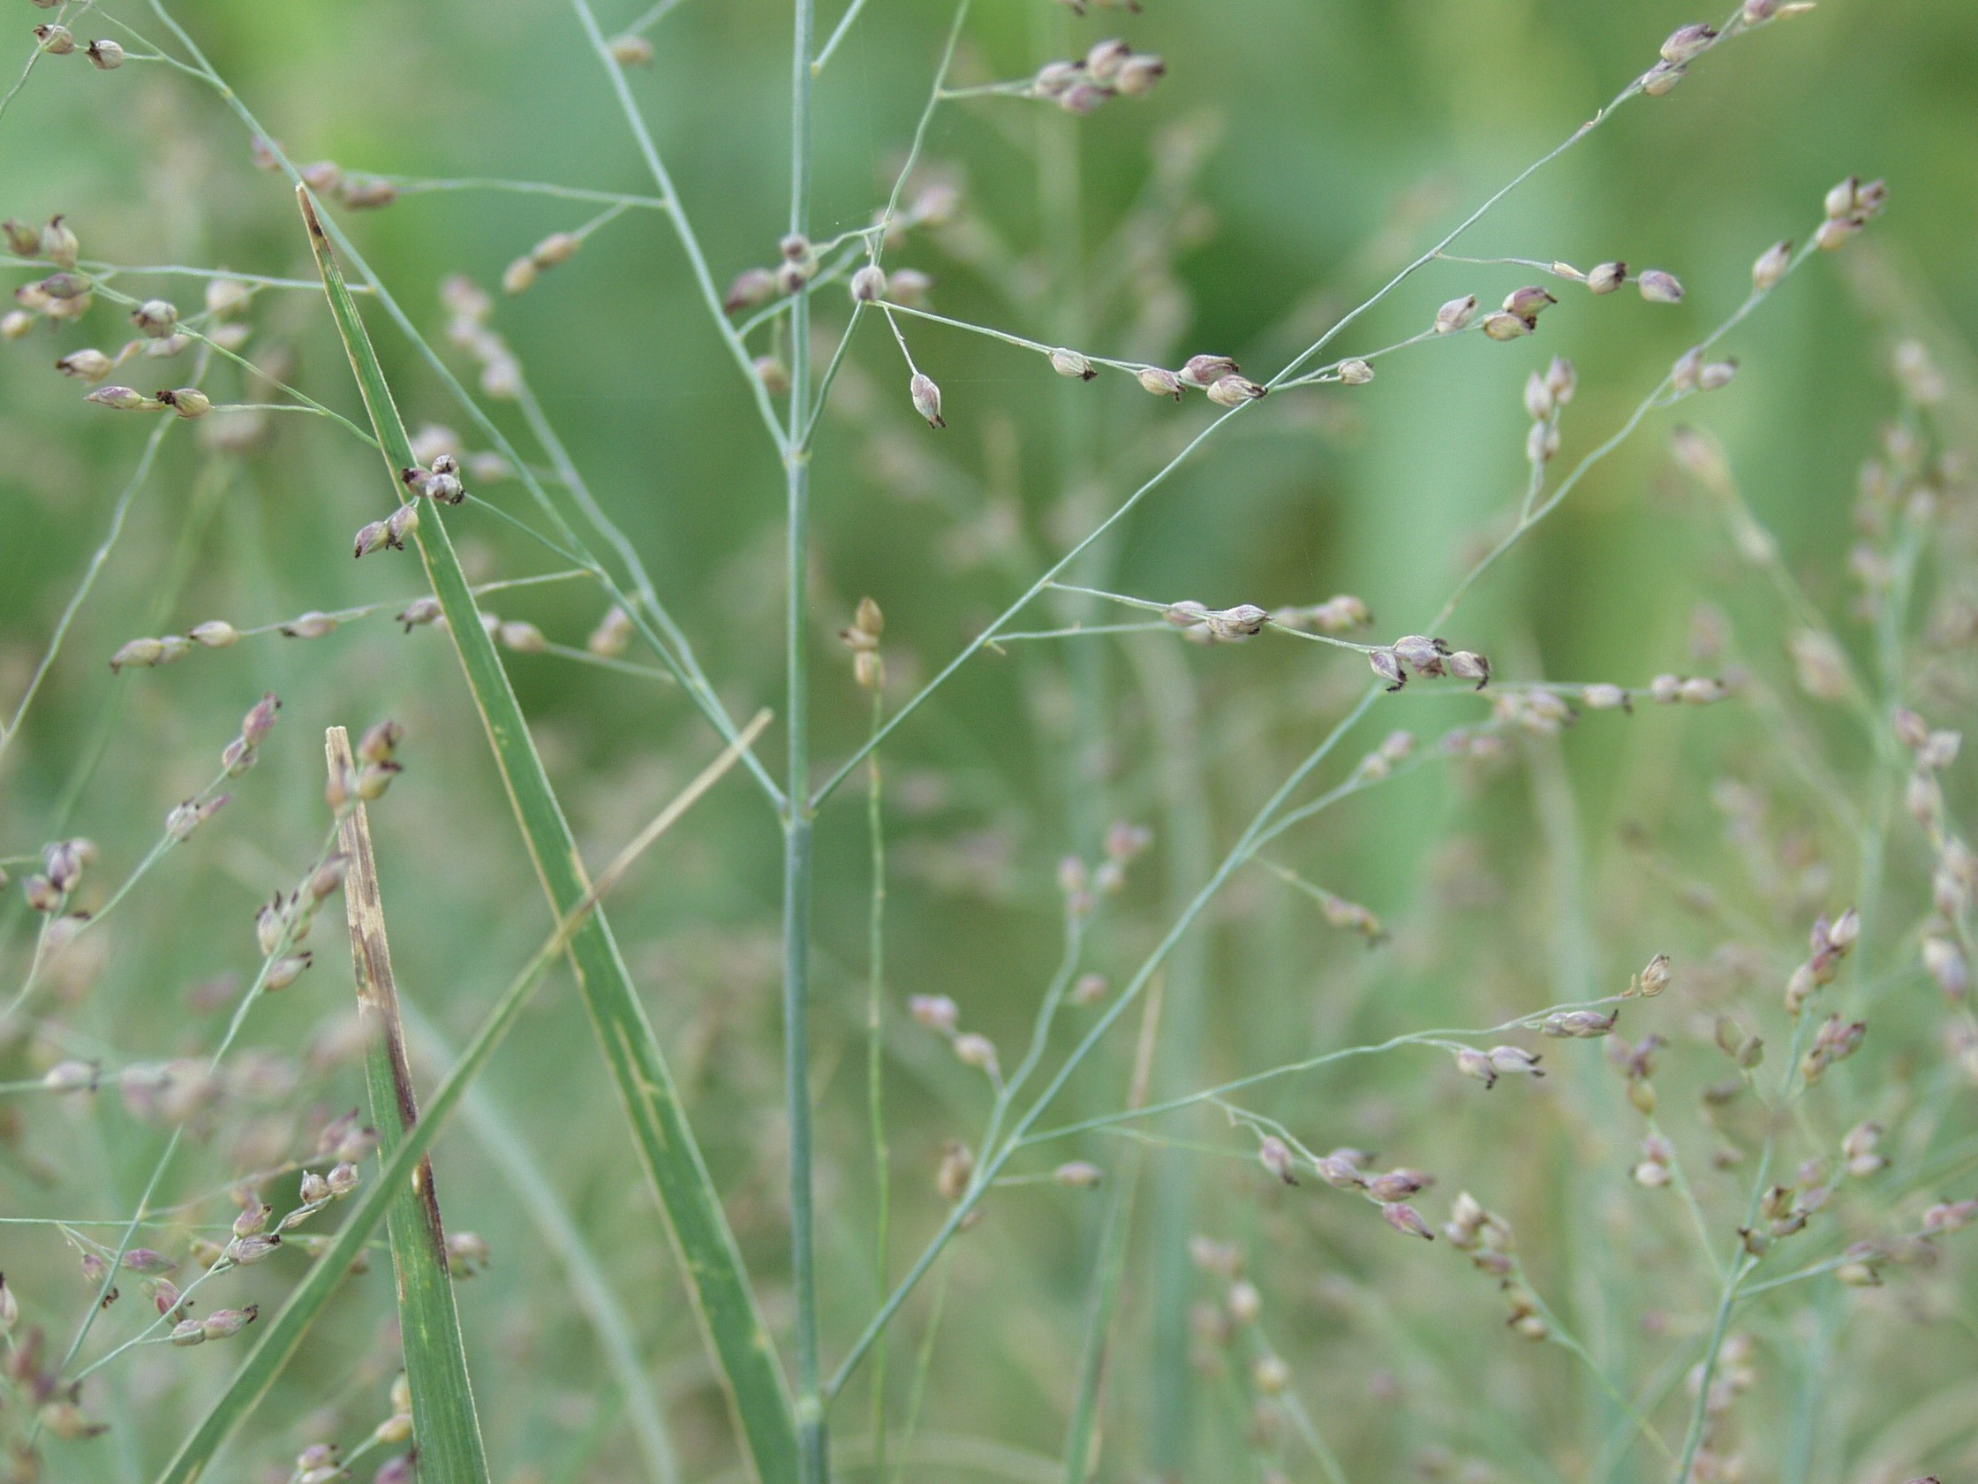
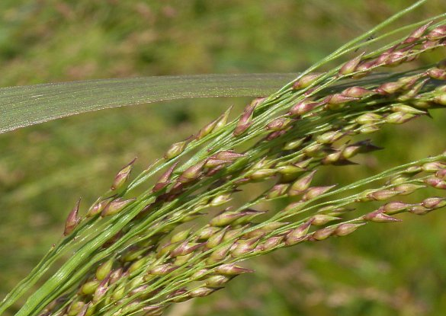
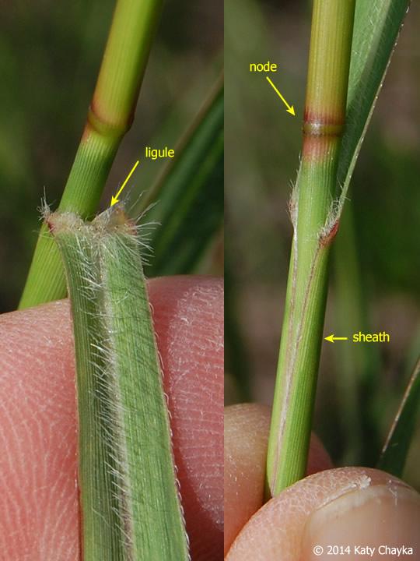
Switchgrass
Panicum virgatum
Photo credit: Texas A&M AgLife Extension https://rangeplants.tamu.edu/plant/switchgrass/
Notes:
https://wimastergardener.org/article/switch-grass-panicum-virgatum/

Slide 7
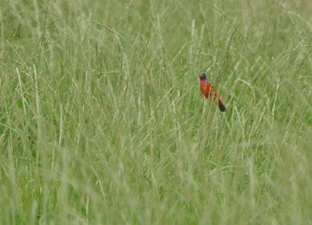
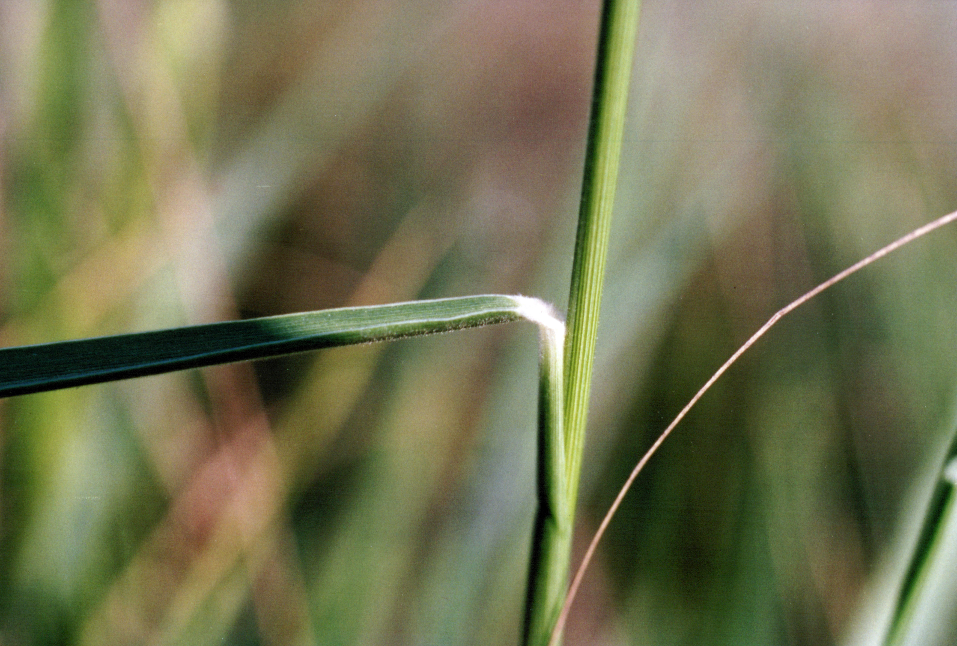
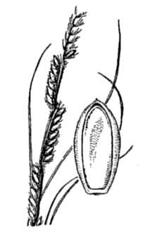
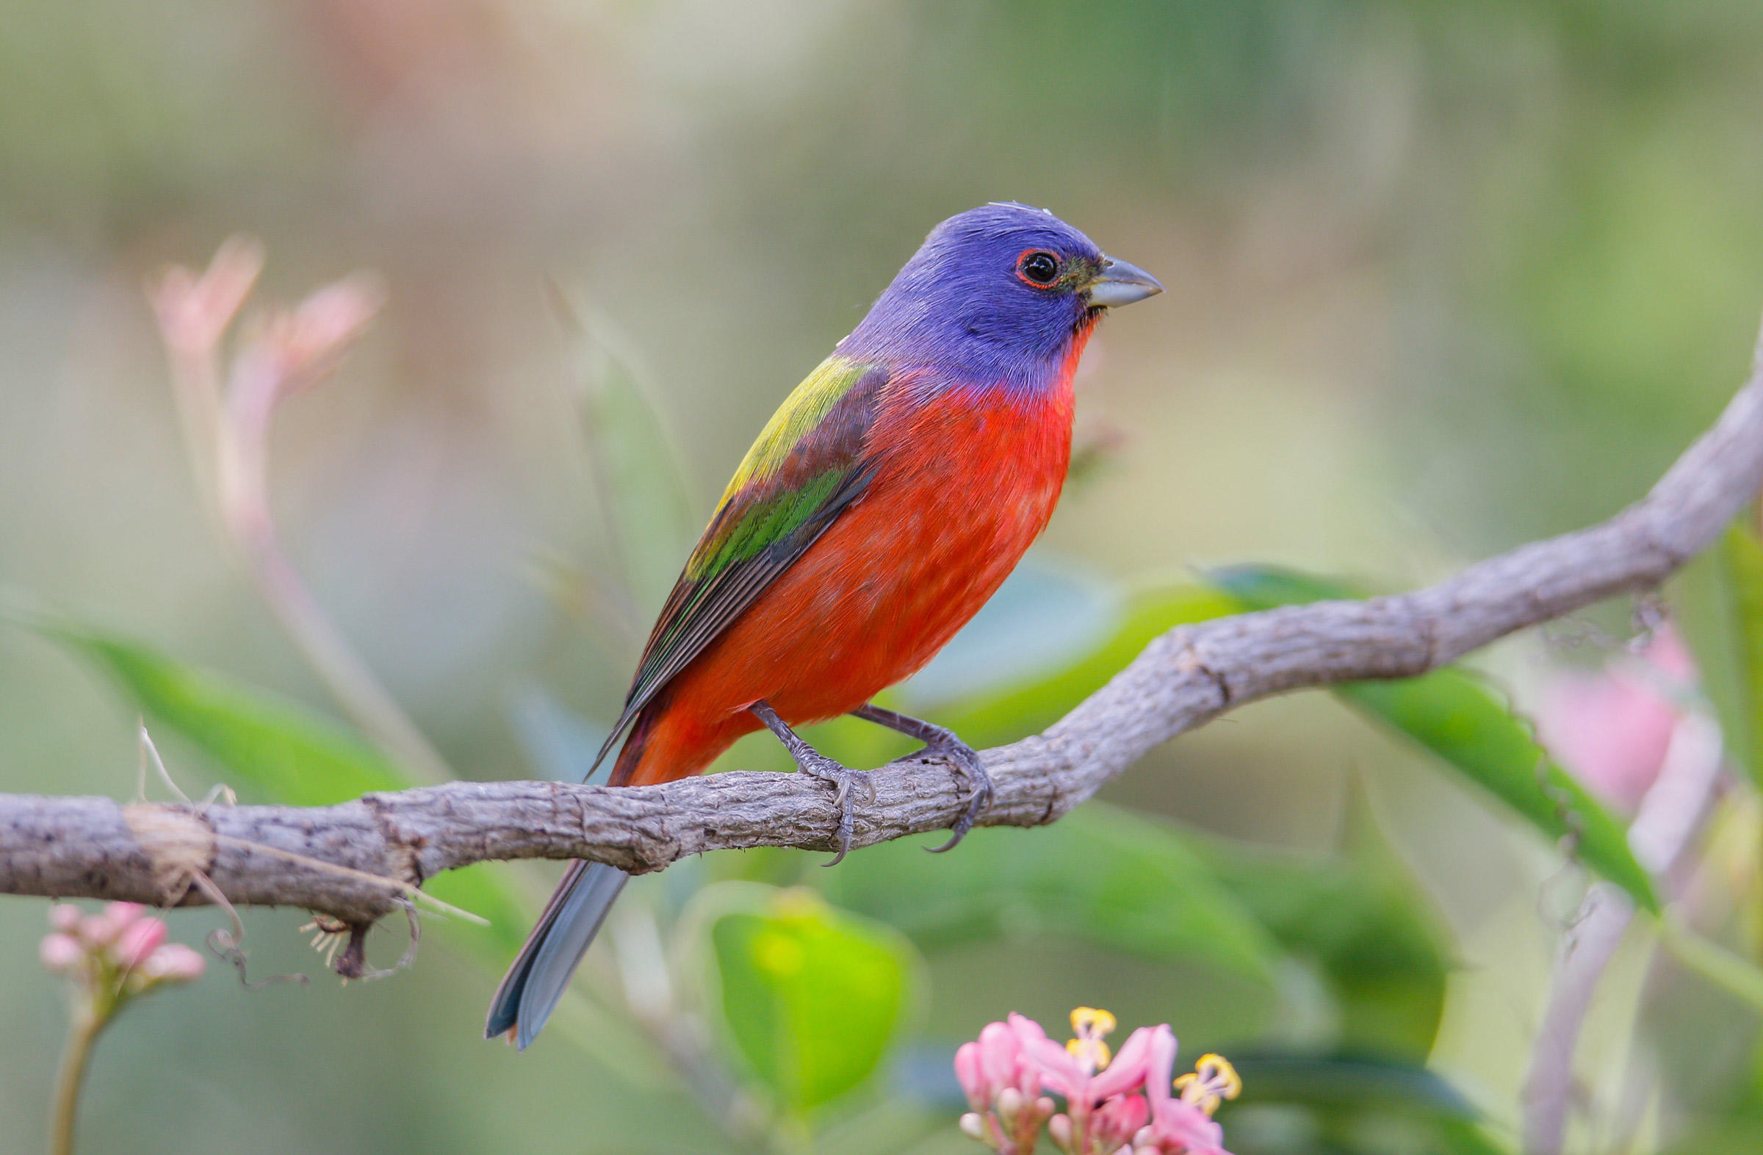
Texas cupgrass
Eriochloa sericea
Photo source: https://www.audubon.org/field-guide/bird/painted-bunting
Notes:
https://www.seedsource.com/catalog/detail.asp?product_id=2515

Slide 8
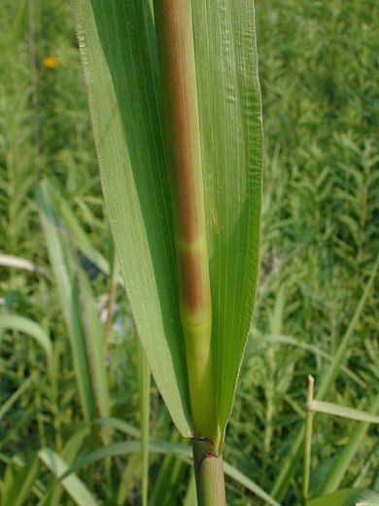
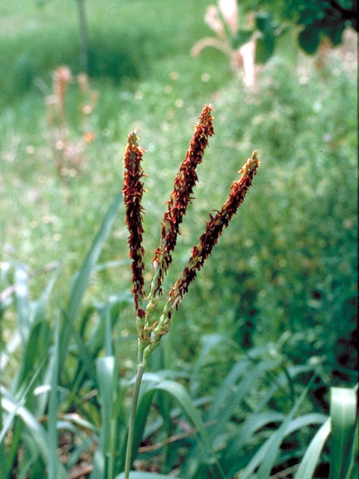
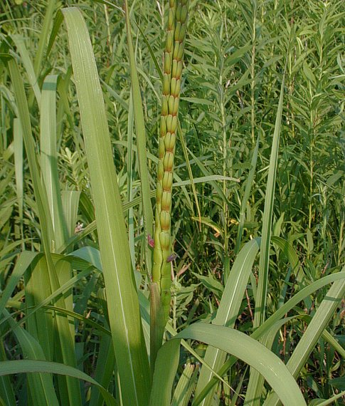
Eastern gamagrass Tripsacum dactyloides

Slide 9
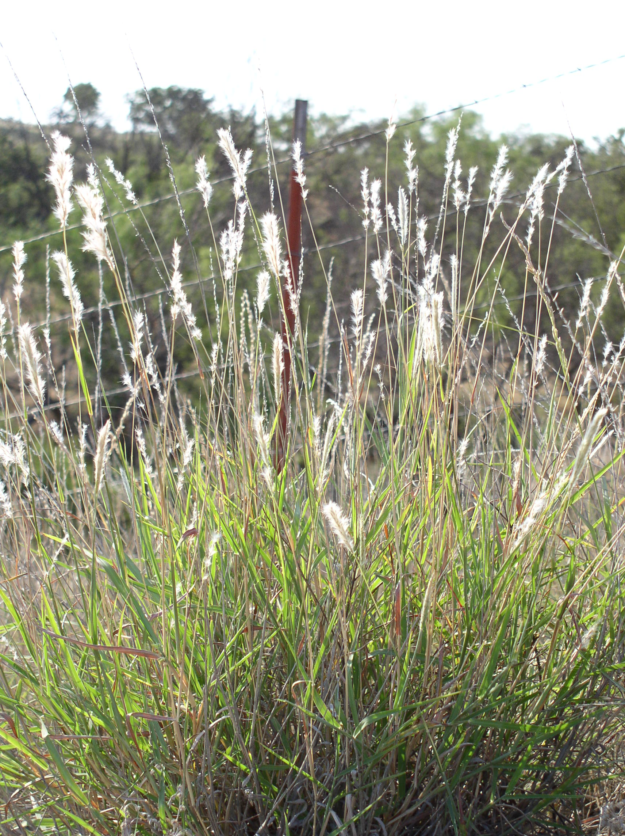
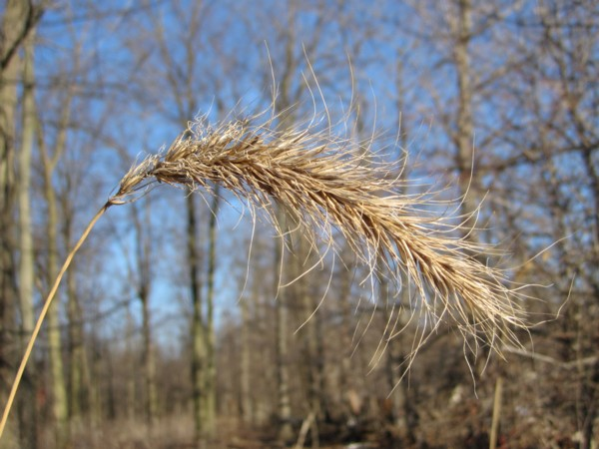
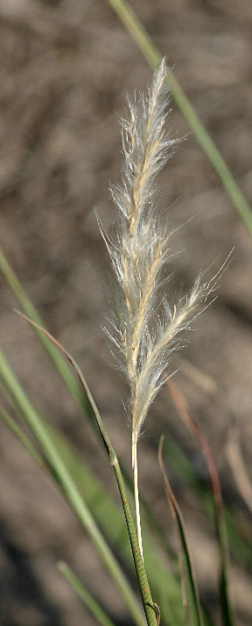
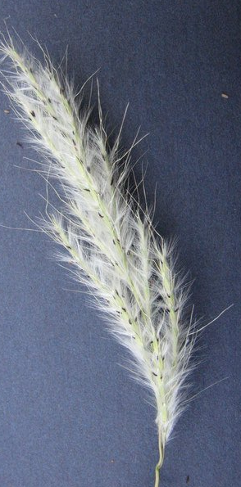
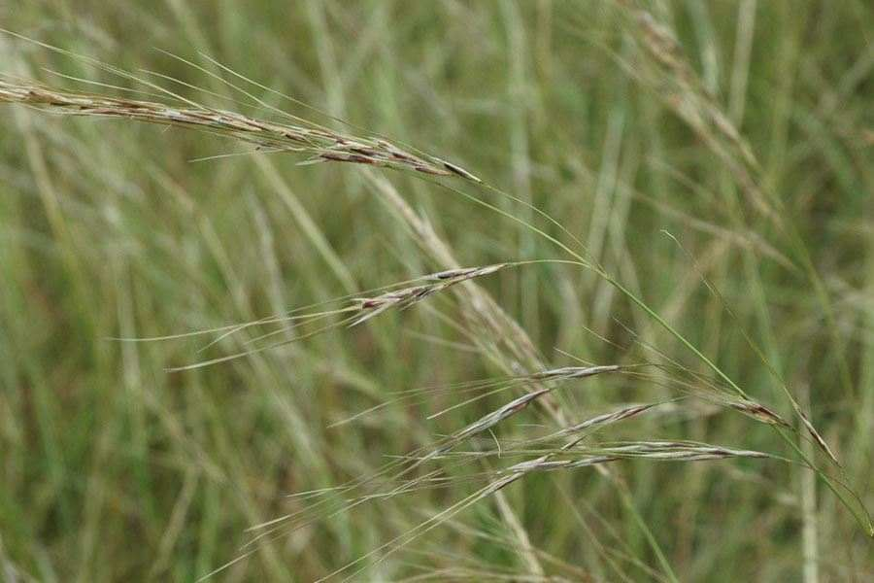
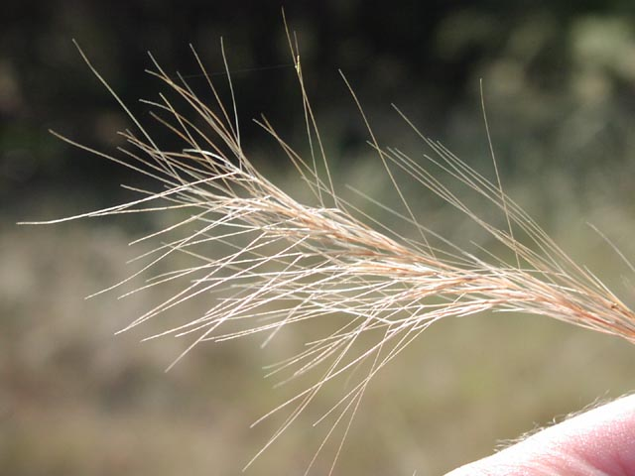
Other native grasses at the site
Canada wildrye
Elymus canadensis
Silver bluestem
Bothriochloa laguroides
Texas wintergrass
Nassella leutrica
Purple three-awn
Aristada purpurea

Slide 10
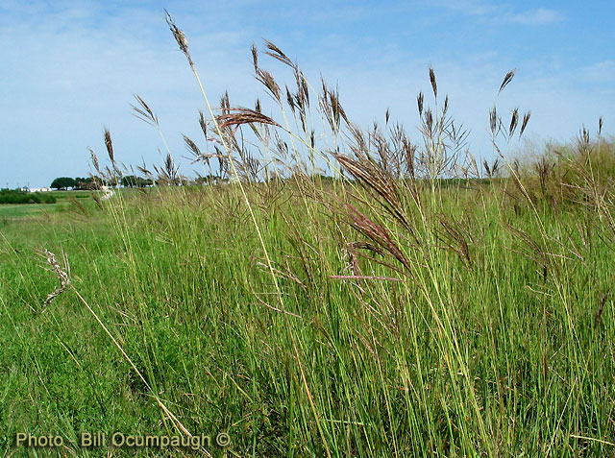
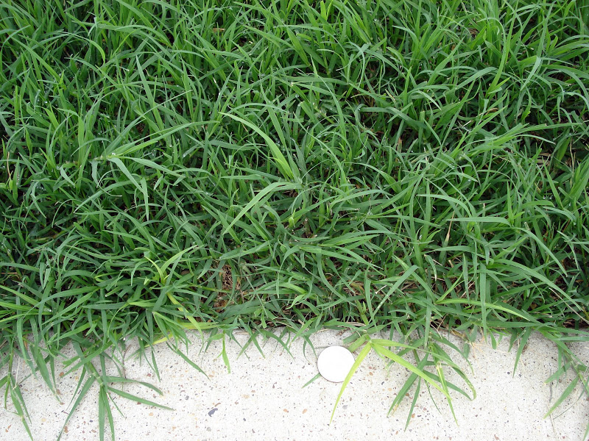
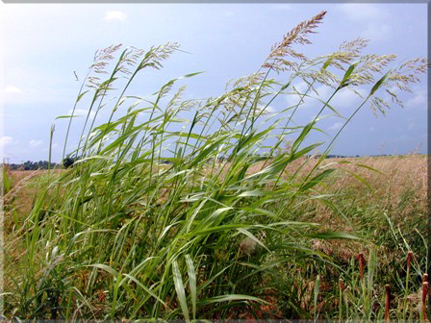
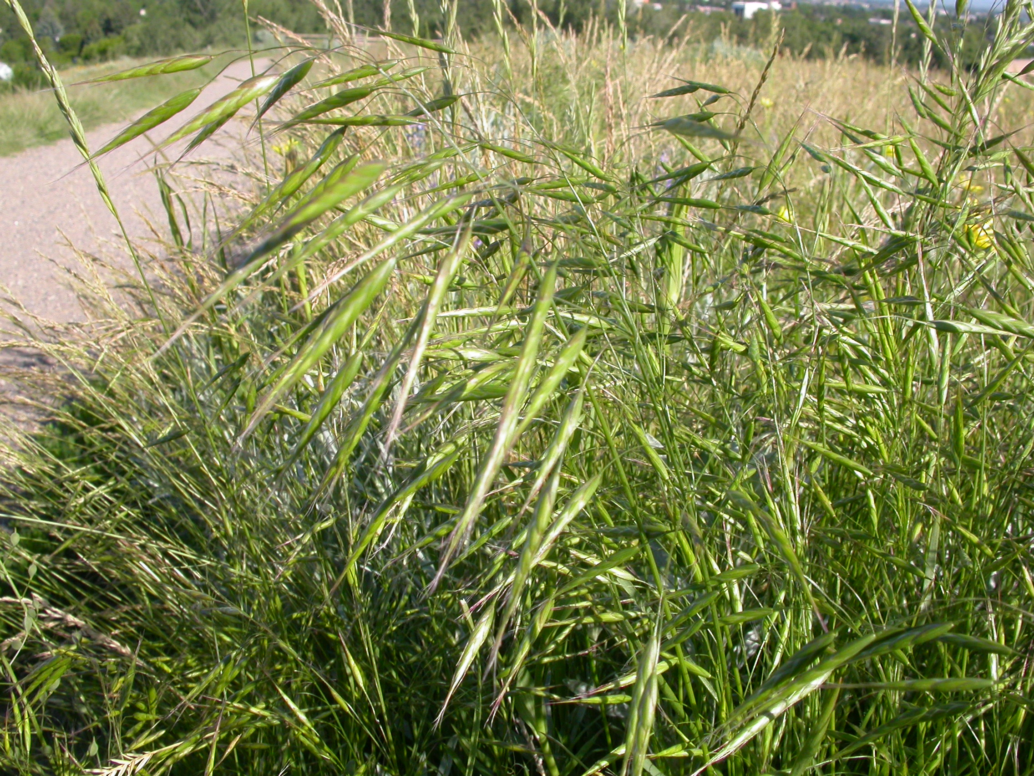
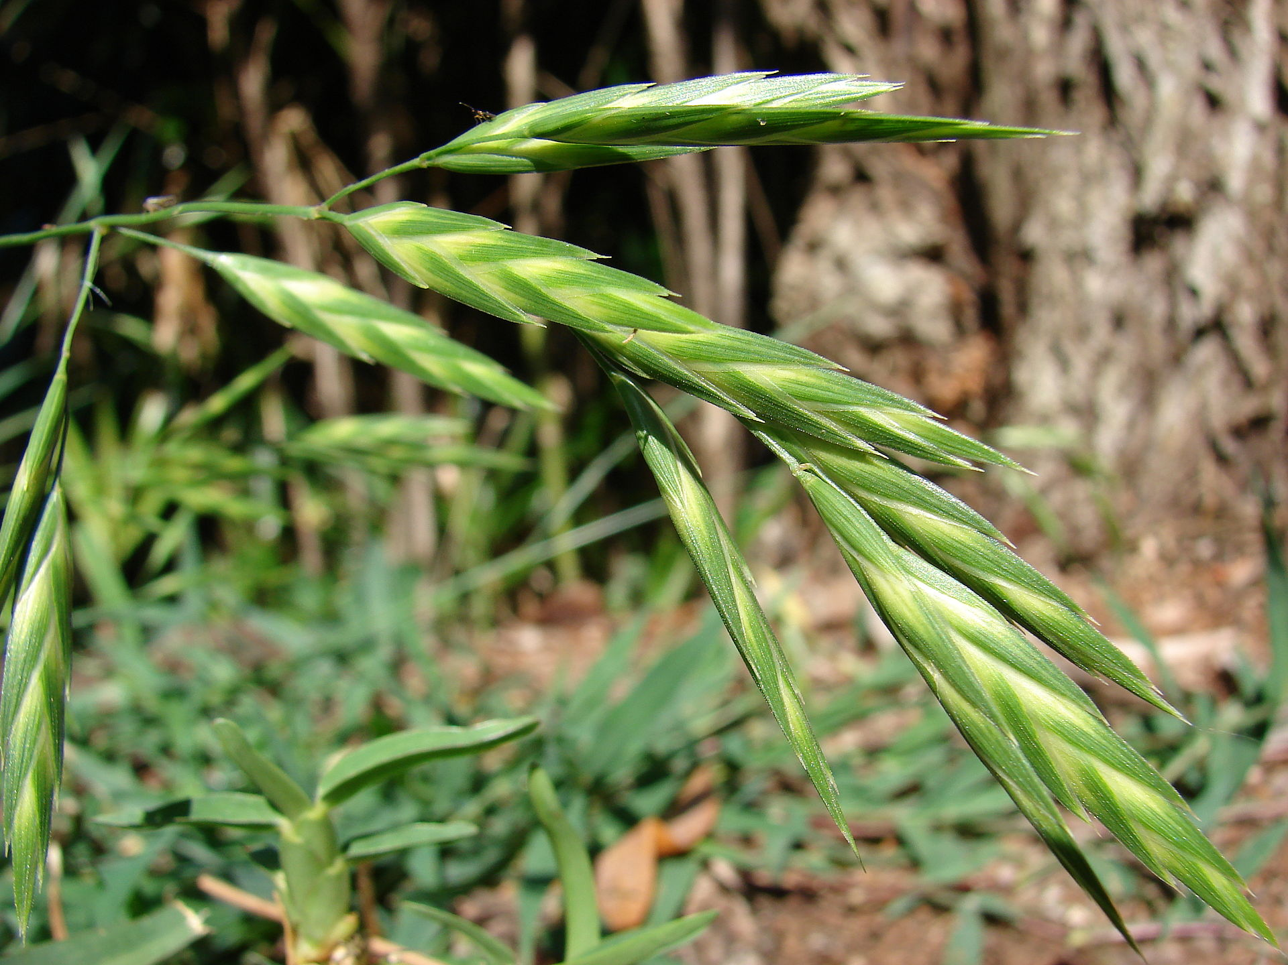
Meet the invasive grasses
Invasive grasses made up > 90% of the total vegetative cover before treatments. Now they make up ~10% or less.
KR Bluestem
Bermudagrass
Johnson grass
Japanese brome
Rescue grass

Slide 11
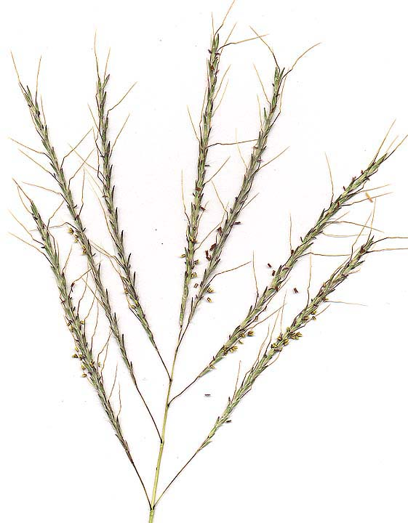
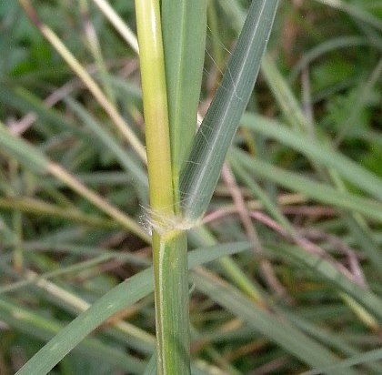
KR Bluestem
Bothriochloa ischaemum

Slide 12
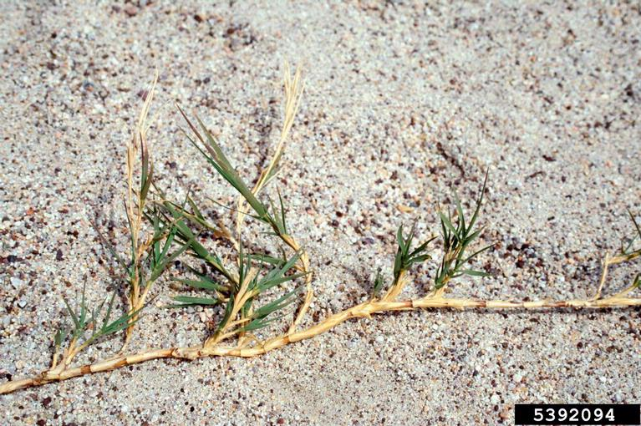
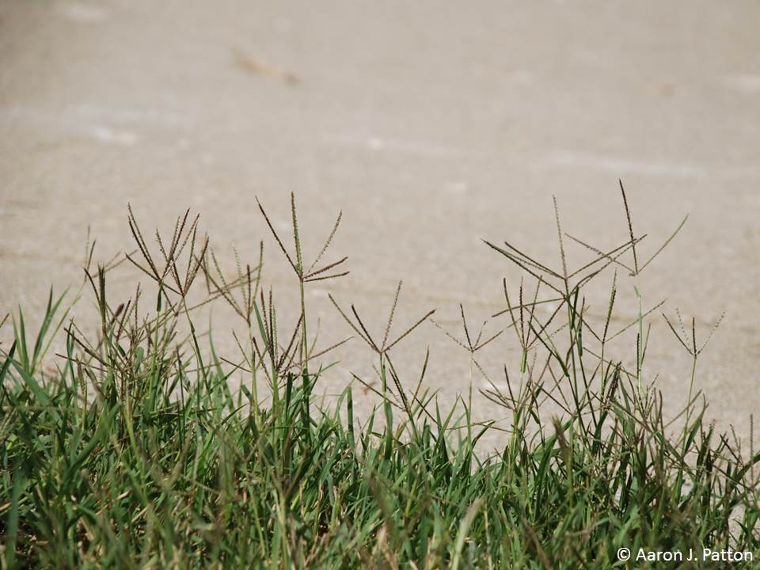
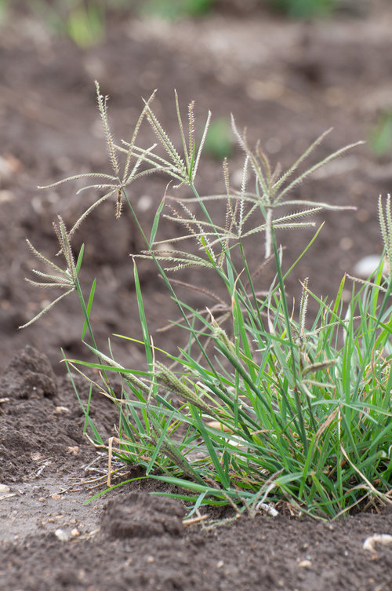
Bermuda grass Cynadon dactylon
Don’t mistake it for native Windmill grass
Chloris cuculata or C. virticillata

Slide 13
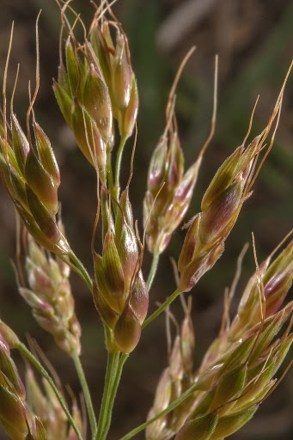
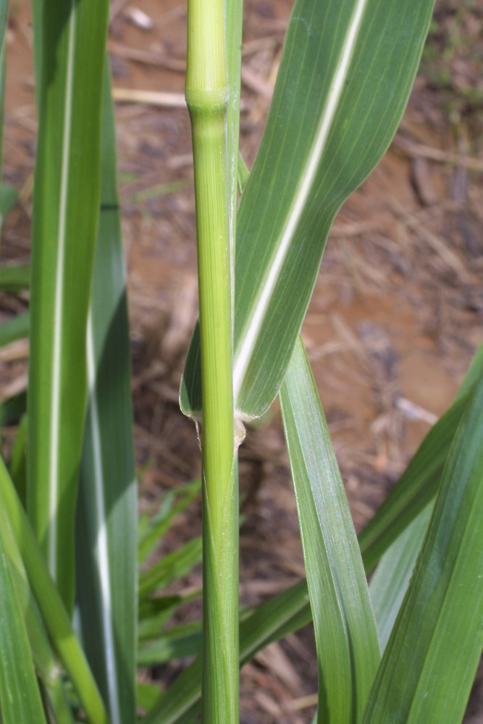
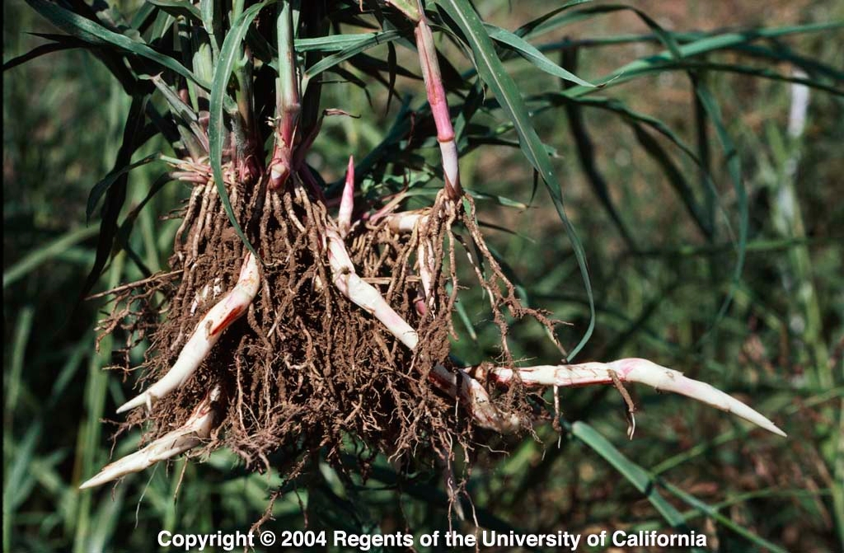
Johnsongrass
Sorghum halipense
Notes:
https://www.illinoiswildflowers.info/grasses/plants/johnson_grass.htm

Slide 14
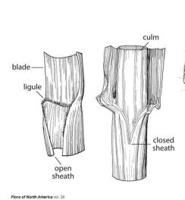
Brome grasses
Brome grasses have a closed sheath
Japanese brome
Bromus japonicus
Rescue grass
Bromus catharticus
Notes:
https://www.minnesotawildflowers.info/grass-sedge-rush/japanese-brome

Slide 15
Aster family
34 species of Aster on the CF list

Slide 16
Aster family
Firewheel
Gaillardia pulchela

Slide 17
Aster family
Engelmann’s daisy
Engelmannia peristenia
Notes:
https://npsot.org/wp/story/2017/9660/

Slide 18
Aster family
Black-eyed Susan
Rudbeckia hirta

Slide 19
Aster family
Mexican hat
Ratibda columnifera

Slide 20
Aster family
Maximillian sunflower
Helianthus maximilliani

Slide 21
Aster family
Bush sunflower
Simsia calva
Common sunflower
Helianthus annuus

Slide 22
Aster family
Gumweed
Grindelia microcephala
Notes:
https://ftp.funet.fi/pub/sci/bio/life/plants/magnoliophyta/magnoliophytina/magnoliopsida/asteraceae/grindelia/

Slide 23
Aster family
American basketflower
Centurea americana

Slide 25
Aster family
Texas thistle
Cirsium texanum
Skeleton plant
Lygodesmia texana

Slide 26
Aster family
Texas gayfeather
Liatrus mucronata
Notes:
https://www.wildflower.org/gallery/result.php?id_image=23065
https://npsot.org/wp/story/2014/6338/

Slide 27
Mint family plants

Slide 28
Mint family plants
Bracts
Flowers
Spotted bee balm
Monarda punctuata
Lemon bee balm
Monarda citridora
Notes:
https://www.wildflower.org/expert/show.php?id=11202

Slide 29
Mint family plants
American germander
Teucrium canadense
Notes:
https://www.illinoiswildflowers.info/savanna/plants/germander.htm

Slide 30
Mint family plants
Mealy blue sage
Salvia faranacea
Notes:
https://npsot.org/wp/story/2014/4971/

Slide 31
Legume family plants
Blue bonnet
Lupinus texensis
Notes:
https://www.prairiemoon.com/dalea-purpurea-purple-prairie-clover-prairie-moon-nursery.html

Slide 32
Legume family plants
Purple prairie clover
Dalea purpurea
Notes:
https://www.prairiemoon.com/dalea-purpurea-purple-prairie-clover-prairie-moon-nursery.html

Slide 33
Antelope horns Asclepias asperula
Other cool wildflowers
Notes:
https://www.gardenstylesanantonio.com/garden-tips-blog/plant/antelope-horn-milkweed/

Slide 34
Standing cypress
Ipomopsis rubra
Notes:
https://npsot.org/wp/story/2015/7622/

Slide 35
Catchfly
Silene antirrhina
Texas vervain
Verbena halei

Slide 36
Limestone gaura
Gaura coccinea
Tenpetal anenome
Anenome berlandieri

Slide 37
Weedy native and exotic forbs
Western ragweed
Ambrosia psilostachya
Bur clover
Medicago minima
Horseweed
Conyza canadensis
Dove weed
Croton monanthogynus
Silverleaf nightshade
Solanum elaeagnifolium

Slide 38
Plants to avoid on your walk
Hedge parsley
Torilis arvensis

Slide 39
Plants to avoid on your walk
Bull nettle
Cnidoscolus texanus

Slide 40
QUESTIONS OR COMMENTS?
More info - amyconcilio.com/outreach/
CFPRO blog - http://commonsfordpro.blogspot.com/
Email me at aconcili@stedwards.edu

